Slide 1





Achieving Consistent Low Latency
for Wireless Real-Time Communications with the Shortest Control Loop
Zili Meng, Yaning Guo, Chen Sun, Bo Wang
Justine Sherry, Hongqiang Harry Liu, Mingwei Xu
Notes:
Hello everyone, I’m Zili from Tsinghua University.
I’m going to introduce our work to achieve consistent low latency for wireless real-time communications with the shortest control loop.

Slide 2

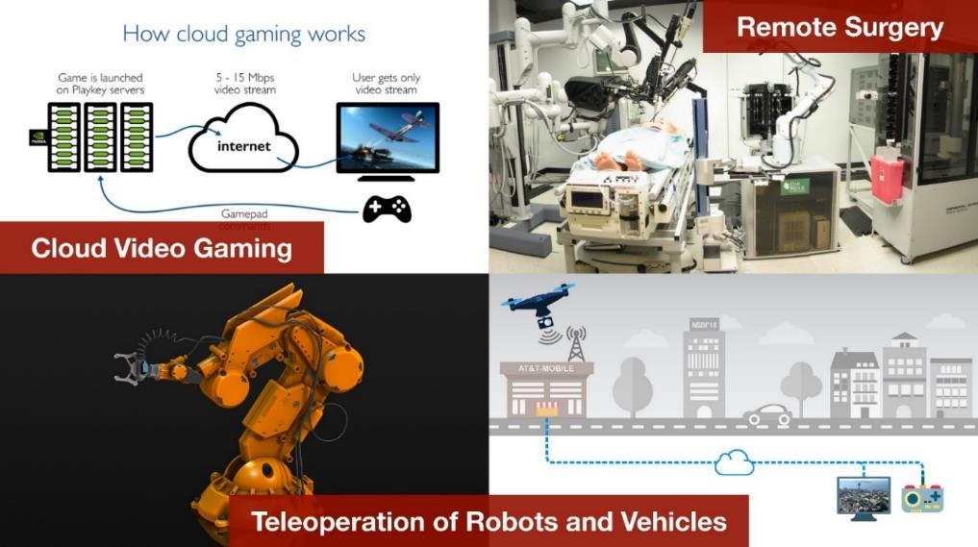
Background
Real-Time Communications
Real-Time Communications (RTC) are increasingly popular.
*Slide taken from Salsify [NSDI’18].
Notes:
Real-time communication, or RTC, is one of the most popular network applications, especially since the start of the pandemic.
2021 is the era of real-time communicaions.
Now we use videoconferencing for work, cloud gaming for entertainment, remote control and surgery in respective fields.
Even SIGCOMM has been held virtually via Zoom in the previous two years.

Slide 3








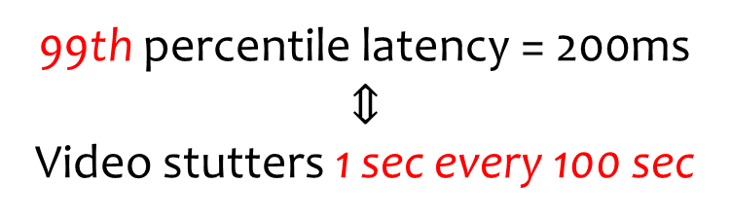
Background
Consistent Low Latency
RTC needs to optimize the tail latency.
99th percentile latency = 200ms
$$⇕$$
Video stutters 1 sec every 100 sec
Notes:
An outstanding feature of RTC is that it requires a consistent low latency, or it needs to optimize the tail latency.
For real-time communications such as live streaming, video conferencing, cloud gaming, and VR/AR, this is very important.
For example, if a video call session has a 99th percentile latency of 200 millisecond, above which users will experience stutters, this implies a video stutter of one second in every a hundred seconds.
Therefore, even a small degradation at the tail will severely degrade the experience of video conferencing or cloud gaming.

Slide 4
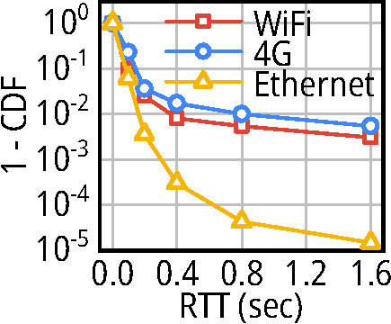


Motivation
Last-mile Wireless Bottleneck
Last-mile access network is the latency bottleneck.
No major differences in the median
Significant differences at the tail
*Measurement from one of Alibaba’s RTC services, with O(1M) users per day.
Notes:
We then want to see where is the bottleneck of the tail.
We collaborate with Alibaba and measure the performance of an RTC service in production.
The x-axis is the network RTT measured from the server, and the y-axis is the complementary CDF.
We categorize the measurement results based on the type of the access network.
We can see from the measurement that users with different networks do not diverge at the median percentiles.
However, the distribution at the tail diverge significantly.
WiFi and 4G users are two order of magnitudes more likely to have a high RTT at the tail.
And in a real scenario where Alice may have videoconferences with the teammates, such a degradation will result in stutters.

Slide 5
Motivation
Last-mile Wireless Bottleneck
Last-mile access network is the latency bottleneck.
The only difference among these categories is the last-mile access network
*Measurement from one of Alibaba’s RTC services, with O(1M) users per day.
Notes:
Note that we are measuring millions of users every day for a week.
The only difference is the last-mile access network, or they are wired or wireless users.
Okay, so what happened at the last mile of wireless network?

Slide 6


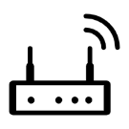
Motivation
Last-mile Wireless Bottleneck
Rapid bandwidth drops happen at the last-mile wireless network.
Wireless link capacity is more fluctuating than wired connection’s.
Wired
Bandwidth drop
Wireless
1
x
Incoming flow
Downlink capacity
1/2
1/6
1/50
Notes:
Our observation here is that there are more rapid bandwidth drops in the wireless network.
For a wireless router, the downlink capacity could be fluctuating, due to the wireless interference from other users or devices such as microwaves.
We measure in several scenarios that how much is the bandwidth going to drop. In other words, if the previous bandwidth is one, what would the current bandwidth be.
Here, the x-axis is the magnitude of bandwidth drop, and the y-axis is the complementary CDF.
For the wired connection, as shown in the green line, 99% of bandwidth drops will only drop by less than a half.
However, for different wireless connections such as 4G, 5G and WiFi, the 99th percentile bandwidth drop is ranging from dropping to one sixth to one fiftith.
This is much more fluctuating than the wired connections.

Slide 7



Motivation
Last-mile Wireless Bottleneck
Rapid bandwidth drops result in rapid delay jitters.
The packet to tell the sender is stuck on the way!
inflates when latency increases!
Congestion control loop
Sender
Last-mile
access point
Receiver
Downlink queue
Downlink WAN
Downlink wireless
Uplink WAN
Uplink queue
Uplink wireless
Reaction Point
Congestion Point
Reflection Point
Congestion control could not solve the problem itself!
How could senders get congestion signals faster?
Notes:
And such rapid bandwidth drops will result in rapid delay jitters.
We simplify the end-to-end transport path as in the figure.
The sender sends the traffic through the wide area network, to the last-mile access point, and via the downlink wireless link to the receiver.
Okay, now assume a congestion occurs at the downlink queue of the last-mile access point.
So the access point is the congestion point.
Specifically, if a new packet arrives at the downlink queue, and observes the congestion.
It cannot tell the sender immediately, because that packet is also stuck on the way!
It first needs to go through the downlink queue, then through the wireless downlink, and be reflected by the receiver, finally reaches the sender.
Only after the whole control loop marked in blue could the sender have any reaction.
However, as we can see from the figure, the control loop from the congestion point to the reaction point, is actually redundant by going through the downlink queue, and wireless links.
Moreover, when the congestion happens, it is usually the downlink queuing delay, wireless link delays that dominate the end-to-end latency, which means that the control loop could also inflate in this case.
Therefore, the congestion control cannot really help itself too much. The question is how could the sender get the congestion signals faster in this case?

Slide 8
Design: Zhuge
Basic Idea
Zhuge avoids the message stayed on the way.
It directly tells the sender when network fluctuates (rapid reaction).
Sender
Last-mile
access point
Receiver
Downlink queue
Downlink WAN
Downlink wireless
Uplink WAN
Uplink queue
Uplink wireless
Reaction Point
Congestion Point
Reflection Point
Eliminate the (inflated) control loop!
Notes:
Now I’m going to talk about our design, Zhuge, or you can also call it Z-huge for your convenience.
Our idea is straightforward.
Since whatever happens on the wireless link, like interference of competition, it has already happened.
So the important thing is to have rapid reactions and tell the sender as soon as possible to reduce the sending rate so that it could adapt to the bandwidth drop quickly.
When the congestion starts to form in the access point, if we could somehow piggyback the congestion information directly to the sender, we could then eliminate the inflated control loop!

Slide 9
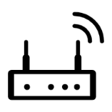










Design: Zhuge
Challenge – Deployability
How to make the solution deployable in the real world?
Design a new protocol?
Not deployable in practice!
Sender
Last-mile
access point
Receiver
Downlink WAN
Downlink wireless
Uplink WAN
Uplink wireless
Notes:
But what can we do to reduce the control loop, for example can we design a new protocol?
If we want to piggyback the congestion message from the access point to the sender, we need to modify both the access point and the sender.
Unfortunately, the senders are usually the content provider like zoom, google, and the access points are maintained by the router vendors like cisco and netgear.
If we need to coordinate these two parties together to have such a protocol deployed, it’ll be extremely hard to deploy in practice.

Slide 10
Design: Zhuge
Challenge – Deployability
How to make the solution deployable in the real world?
Solution: Patch on the last-mile router only!
Sender
Last-mile
access point
Receiver
Downlink WAN
Downlink wireless
Uplink WAN
Uplink wireless
Notes:
Since the control loop happens in the network, there is nothing we can do from the sender side.
So we want to limit our modification to the router, and see if we can solve the problem by modifying the last-mile router only.

Slide 11



Design: Zhuge
Challenge – Effectiveness
How to piggyback the network condition in existing protocols?
Different Applications
Different Protocols
TCP
QUIC
RTP/RTCP
Different CCAs
Copa
[NSDI’18]
BBR
[Queue’16]
GCC
[MMSys’16]
NADA
[RFC 8698]
Scream
[RFC 8298]
Notes:
Subsequently, if we do not modify the sender, how could we send the network condition back to the sender?
Especially considering that there are various applications on video conferencing, cloud gaming, and live streaming;
Different protocols such as TCP QUIC and RTP
And also numerous congestion control algorithms in recent years on real-time communications.

Slide 12



Design: Zhuge
Challenge – Effectiveness
How to piggyback the network condition in existing protocols?
Solution: Zhuge Feedback Updater (for protocols)
Zhuge Fortune Teller (for CCAs)
Fortune Teller
Downlink queue
Data packet (downlink)
Predictions
Feedback Updater
Feedback packet (uplink)
Sender
Receiver
Last-mile access point
Notes:
On the last-mile access point which connects to the sender via Ethernet and the receiver via wireless links,
the data flows of the downlink and uplink packets are presented in the slide.
We introduce a feedback updater to accordingly piggyback the network conditions into different protocols from the router back to the server.
And a fortune teller to tell the updater what information to notify back to the sender.
And I’m going to share several insights in the following slides.

Slide 13
Design: Zhuge
Feedback Updater
How to piggyback the network condition in existing protocols?
Different Applications
Different Protocols
TCP
QUIC
RTP/RTCP
Notes:
For Feedback Updater [next slide]

Slide 14
Design: Zhuge
Feedback Updater
Applications
Protocols
TCP
QUIC
RTP/RTCP
Out-of-band feedback
In-band feedback
Notes:
Our observation is to categorize them into two types – out of band feedback and in band feedback.
We then accordingly piggyback the information for different protocols.

Slide 15

Design: Zhuge
Feedback Updater
Protocols
TCP
QUIC
RTP/RTCP
Out-of-band feedback
In-band feedback
Data
Data
Data
Data
Data
Data
Sender
Receiver
Sender
Receiver
t
Feedback
Solution: Delaying ACKs
Solution: Updating Payloads
Notes:
So what is out of band feedback and in band feedback?
Out of band feedback means that the feedback information is not in the payload of feedback packets.
For example, in TCP, the ACK packets do not carry any payload information.
It is the sender that receives the ACK packets, matches them with the timestamps of sending out, and calculates the network conditions.
In contrast, in band feedback is to explicitly write the network conditions, such as the time intervals between the arrivals of two packets, in the payload of the feedback packet.
The RTCP protocol, used by WebRTC, adopts this mechanism.
For out of band feedback, our solution is to delay the ACK packets with carefully designed time intervals to carry the network conditions back.
For in band feedback, we could directly overwrite the feedback information to carry the conditions back.

Slide 16
Design: Zhuge
Feedback Updater
Out-of-band feedback – Delaying ACKs to encode network conditions.
Sender
Last-mile
access point
Receiver
Downlink WAN
Downlink wireless
Uplink WAN
Uplink wireless
Notes:
Let’s first take a look at the out of band feedback.
When the blue packet arrives at the congestion point and discover the congestion, without our solution, it needs to go through the whole feedback loop, as marked in blue.
Our observation is that it usually happens to have ACK packets in the reverse direction of the same flow in the same time, but acknowledge previous packets.
For example, the green packets in the figure.
We could actually adjust the intervals of these ACK packets to carry the delay increase information back.
In this way, the congestion message no longer needs to be stuck in the data path.

Slide 17

Design: Zhuge
Feedback Updater
In-band feedback – Updating payloads in the network condition feedback messages.
pkt status¹
recv delta²
recv delta
recv delta
recv delta
recv delta
recv delta
¹Whether a packet is received, with a small / large / negative delta.
²The time delta between the delivery of two packets.
Transport-wide Congestion Control (TWCC) Feedback Format
Notes:
For in band feedback, where the feedback packet has the following format.
This format is the transport wide congestion control feedback from WebRTC.
We could just rewrite the respective field in the feedback to carry the information back.

Slide 18
Design: Zhuge
Fortune Teller
Different CCAs
Copa
[NSDI’18]
BBR
[Queue’16]
GCC
[MMSys’16]
NADA
[RFC 8698]
Scream
[RFC 8298]
Different
congestion signals
RTT
ECN
delay gradients
packet loss
delivery rate
How should we delay / update?
Congestion signals are processed from packets’ feedback timestamps.
Notes:
Another important thing is how we should provide the right information back to the sender?
Since we have various congestion control algorithms, which are sensitive to different signals like RTT, delay gradients, loss or others, it is non trivial to tell them about the network condition.
So the question is how to delay or update the packets.
Our insight here is that all these congestion signals are actually processed from the timestamps of receiving packets at the sender side.
So what are these timestamps?

Slide 19
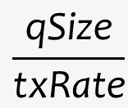
Design: Zhuge
Fortune Teller
Congestion signals are processed from packets’ feedback timestamps.
Last-mile
access point
Receiver
Downlink queue
Downlink wireless
One packet should know its feedback time upon arrival!
$$\frac{\text{qSize}}{\text{txRate}}$$
feedback = curTime + qDelay + txDelay
Notes:
From the view of the access point, the time to feedback or acknowledge a packet is just the time of queueing delay and wireless transmission delay.
In fact, we could accordingly predict these two parts of delay by measuring the queue size and transmission rate.
Please refer to the paper for more details on how we predict and avoid practical issues such as handling out-of-order packets etc.

Slide 20

Evaluation
Trace-driven Simulation
NS-3 Simulation
Zhuge application:
  WebRTC (UDP) with GCC
5 sets of bandwidth traces:
  two WiFi (W1, W2)
  three cellular (C1, C2, C3)
Baselines:
  FIFO
  CoDel [Queue’12]
Metrics
  Network RTT
Sender
Router
Receiver
Bandwidth limit
(from traces)
Notes:
So we first perform an NS-3 simulation of Zhuge.
We implement Zhuge over the WebRTC.
For in band we use Google Congestion Control, or GCC, over RTP/RTCP.
We use five sets of real-world traces in different scenarios such as outdoor, office, restaurant, with 4G, 5G, and WiFi access network.
We also implement a series of baselines.
we compare Zhuge with two active queue management strategies, FIFO and CoDel, which are two options in Linux kernel.
We measure the network RTT in different experiments.

Slide 21
Evaluation
Trace-driven Simulation
NS-3 Simulation
Zhuge application:
  WebRTC (UDP) with GCC
5 sets of bandwidth traces:
  two WiFi (W1, W2)
  three cellular (C1, C2, C3)
Baselines:
  FIFO
  CoDel [Queue’12]
Metrics
  P(Network RTT > 200ms)
GCC does not respond to packet losses unless the loss rate is high.
Zhuge outperforms the better of FIFO and CoDel by 45%-75%.
minRTT = 50ms
Distributions in the paper
Notes:
We present the ratio when RTT is larger than 200ms, which is the recommended value by ITU that users will start to experience stutters.
We then find that CoDel has a comparable performance against FIFO, sometimes better but sometimes worse.
That is because the key design in CoDel is to drop packets earlier, but recent delay-based CCAs such as GCC, Copa are not very sensitive to loss signals.
Therefore, the retransmitted packets will retroactively fill the bottleneck queue, leading to the increase of network RTT.
In contrast, Zhuge outperforms the better of these two baselines, by a half or more.

Slide 22
Evaluation
… and more!
Zhuge works with TCP-based applications.
Microbenchmarks under flow competition and wireless interference.
Accuracy of Fortune Teller in delay prediction.
Inter-queue and intra-queue fairness.
Performance with commercial (OpenWrt) routers (Netgear / TP-Link)
Computational overhead on routers.
Please refer to the paper for details!

Slide 23
Takeaway
The inflated control loop affects the tail latency in wireless.
Zhuge decouples the control loop from the data path.
Zhuge is deployable and generalizable for different CCAs, protocols, apps.
Zhuge improves the application performance by 17%-95%.

Slide 24
Achieving Consistent Low Latency for Wireless Real-Time Communications with the Shortest Control Loop
Thank you!
Zili Meng
zilim@ieee.org
Notes:
We’re now in the process of pushing Zhuge and follow-up works to be deployed in some real-world products.
If there are any collaboration chances for the follow-up work, please reach out to me and I’ll be more than happy to have a chat.
Thank you all for listening to our talk and I’d like to take any questions.

Slide 25
Background
Consistent Low Latency
Existing optimizations mostly focus on the median latency.
TCP Cubic
TCP NewReno
TCP BBR
TCP Copa
Low median latency
Bottleneck queue
Latency
Time
Notes:
What is the consistent low latency?
For most of recent advances in networking, researchers devote many efforts into optimizing the median latency.
For example, recent congestion control algorithms, such as TCP BBR or TCP Copa, will try to maintain the low queue occupancy to reduce the queue length.

Slide 26
Background
Consistent Low Latency
RTC needs to optimize the tail latency.
Low median latency
Low tail latency
Latency
tail latency
Time
Notes:
Tail latency is a different thing.
Let’s see this example.
If a flow is from the server, via a wireless router, to a user.
And let’s take a look at the latency of the flow in different time.
At first, everything is normal, so the latency just goes smooth in a low level.
But after that, something might happen. Such as a new user starting to send traffic to the same router, or even wireless interference like microwaves.
In that case, the available bandwidth for that flow will decrease, and the flow will experience a latency jitter.
But the congestion control could quickly converge to the new steady state, so only a spike of latency is observed, which is the tail latency.

Slide 27

Background
Consistent Low Latency
RTC needs to optimize the tail latency.
Real-time communications (RTC)
Low median latency
(e.g., latency-sensitive congestion control)
+
Low tail latency
||
99th percentile latency = 200ms
$$⇕$$
Video stutters 1 sec every 100 sec
Consistent low latency
Notes:
An outstanding feature of RTC is that it requires a consistent low latency, or it needs to optimize the tail latency.
In terms of the optimizations of the median latency, existing efforts such as latency-sensitive congestion control algorithms have already done an amazing work.
So if an application is requiring both low median latency and low tail latency, we say it requires a consistent low latency.
For real-time communications such as live streaming, video conferencing, cloud gaming, and VR/AR, achieving a consistent low latency is very important.
For example, a 99th percentile latency of 200 millisecond implies a video stutter of one second in every a hundred seconds, which will severely degrade the experience of video conferencing or cloud gaming.

Slide 28
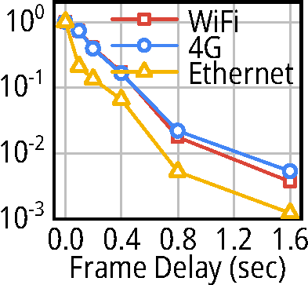
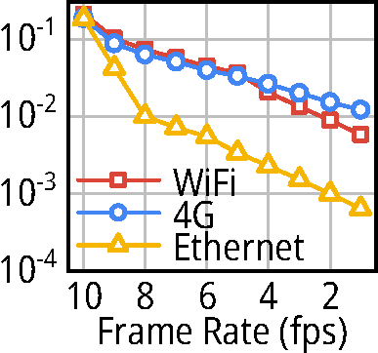
Motivation
Last-mile Wireless Bottleneck
No major differences in the median
Affect the application performance
Significant differences at the tail
*Measurement from one of Alibaba’s RTC services, with O(1M) users per day.
Notes:
We then want to see where is the bottleneck of the tail.
We collaborate with Alibaba and measure the performance of an RTC.
We can see from the measurement that users with different networks do not diverge at the median percentiles.
However, the distribution at the tail diverge significantly.
WiFi and 4G users are two order of magnitudes more likely to have a high RTT at the tail.
And the degradation of the network layer metric finally affect the performance of the application.

Slide 29
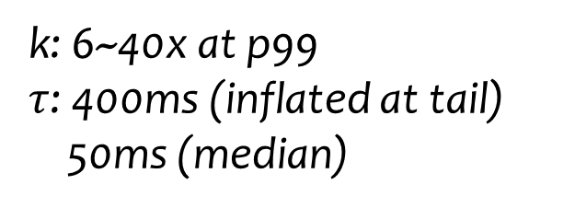
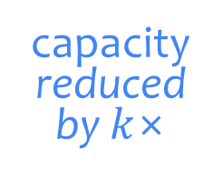
Motivation
Last-mile Wireless Bottleneck
The influence of capacity fluctuation lasts several control loops.
control loop
bitrate
capacity
$$τ$$
capacity
reduced by $k$×
controlled by the sender
controlled by the wireless link
Sending Rate
bitrate
Time
k: 6~40x at p99
$τ$: 400ms (inflated at tail)
50ms (median)
$$kτ$$
x10s more stutters
time to drain the excessively sent packets
Notes:
Moreover, for RTC, the capacity fluctuations of the wireless link could last for several control loops.
So if the link capacity reduces by k times, and the receiving rate of the wireless router will react after one control loop, as shown in the figure.
However, since the bandwidth is reducing, all packets received by the router during this control loop needs the time of multiple control loops to be drained, during which the latency is still very high.
Considering the bandwidth reduction ratio is tens of times, and the RTT could also inflate by several times and result in more stutters.

Slide 30
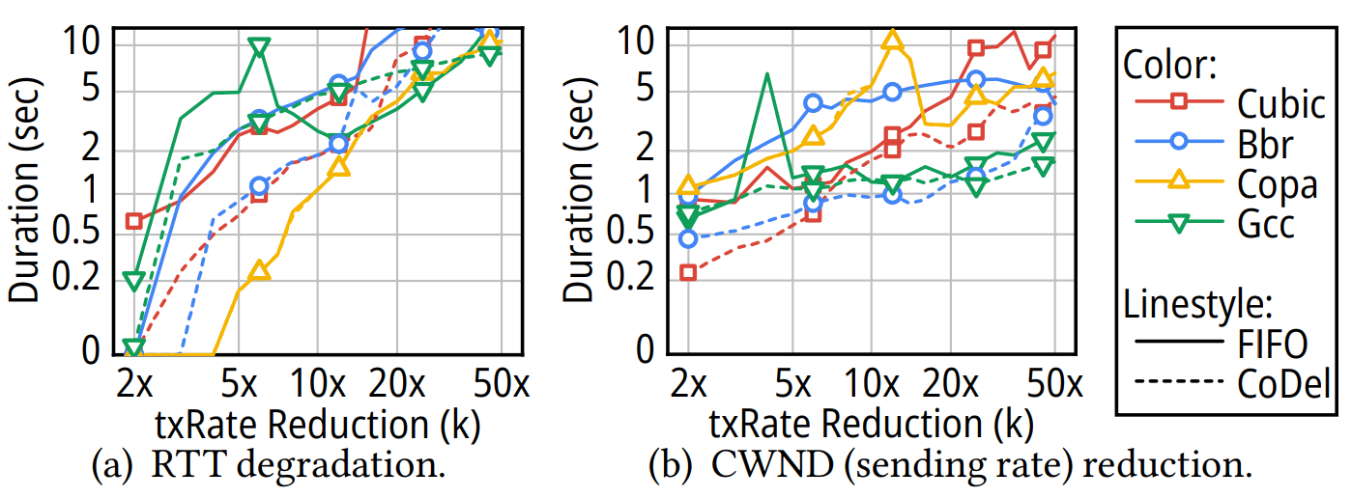
Motivation
Last-mile Wireless Bottleneck
The delayed feedback leads to performance degradation.
Notes:
Moreover, for RTC, the capacity fluctuations of the wireless link could last for several control loops.
So if the link capacity reduces by k times, and the receiving rate of the wireless router will react after one control loop, as shown in the figure.
However, since the bandwidth is reducing, all packets received by the router during this control loop needs the time of multiple control loops to be drained, during which the latency is still very high.
Considering the bandwidth reduction ratio is tens of times, and the RTT could also inflate by several times and result in more stutters.

Slide 31
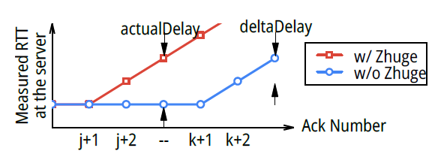
Design: Zhuge
Feedback Updater
What will the sender see when using Zhuge?
Zhuge shifts the curve of RTT forward by delaying earlier returning ACK packet to quickly feedback network conditions.

Slide 32
Design: Zhuge
Feedback Updater
Out-of-band feedback – Delaying ACKs
(3’) Server detects delay increases w/ Zhuge
(3) Server detects delay increases w/o Zhuge
Reduced control loop
Server
(2’) adjust delay
Seq k
Seq k+1
Ack j+1
Ack j+2
Ack j+2
Ack k+1
Ack k+2
(2) increased delay fed back
Ethernet
(1) delay increased
Access Point
(2 interfaces)
(1’) delay prediction
Wireless
Timeline
Client
Notes:
Let’s first take a look at the out of band feedback.
Let’s see the timeline of a normal TCP packet when the network congestion starts to accumulate.
For two packets with sequence number k and k + 1, when the downlink capacity is reduced, at here, this is the first time when sequence number k + 1 experiences an increased delay.
And then these two packets need to be reflected to the server, which is too late.
Okay so what will Zhuge do in this case?
Actually when the packet with sequence k + 1 arrives at the access point, if the downlink capacity is reduced, it could have already been predicted here.
Suppose there are other packets in the reverse direction from the client to the server, such as ack j + 1 and j + 2, Zhuge can directly manipulate the delay intervals between them by delaying the second ack packet.
In this case, the server will know the delay is increasing in the network now.
And the control loop will be reduced as marked in green.

Slide 33
Design: Zhuge
Feedback Updater
Token-based delay mechanism to preserve packet orders
Delay deltas will be put into token bins.
Fortune Teller
Downlink queue
Data packet (downlink)
Predictions
Delay delta tokens
Feedback Updater
Feedback packet (uplink)
Sender
Receiver
Reverse ACK packets will be blocked if there are unused tokens.
Last-mile access point
Notes:
Let’s first take a look at the out of band feedback.
Let’s see the timeline of a normal TCP packet when the network congestion starts to accumulate.
For two packets with sequence number k and k + 1, when the downlink capacity is reduced, at here, this is the first time when sequence number k + 1 experiences an increased delay.
And then these two packets need to be reflected to the server, which is too late.
Okay so what will Zhuge do in this case?
Actually when the packet with sequence k + 1 arrives at the access point, if the downlink capacity is reduced, it could have already been predicted here.
Suppose there are other packets in the reverse direction from the client to the server, such as ack j + 1 and j + 2, Zhuge can directly manipulate the delay intervals between them by delaying the second ack packet.
In this case, the server will know the delay is increasing in the network now.
And the control loop will be reduced as marked in green.

Slide 34


Design: Zhuge
Feedback Updater
How Zhuge handles rate-based CCAs (e.g., BBR).
Queueing delay is continuously increasing.
Fortune Teller
Downlink queue
Data packet (downlink)
Predictions
Feedback Updater
Feedback packet (uplink)
Sender
Receiver
As if we stretch the ACK packets.
$$t+Δt$$
$$t$$
Last-mile access point
Notes:
Let’s first take a look at the out of band feedback.
Let’s see the timeline of a normal TCP packet when the network congestion starts to accumulate.
For two packets with sequence number k and k + 1, when the downlink capacity is reduced, at here, this is the first time when sequence number k + 1 experiences an increased delay.
And then these two packets need to be reflected to the server, which is too late.
Okay so what will Zhuge do in this case?
Actually when the packet with sequence k + 1 arrives at the access point, if the downlink capacity is reduced, it could have already been predicted here.
Suppose there are other packets in the reverse direction from the client to the server, such as ack j + 1 and j + 2, Zhuge can directly manipulate the delay intervals between them by delaying the second ack packet.
In this case, the server will know the delay is increasing in the network now.
And the control loop will be reduced as marked in green.

Slide 35
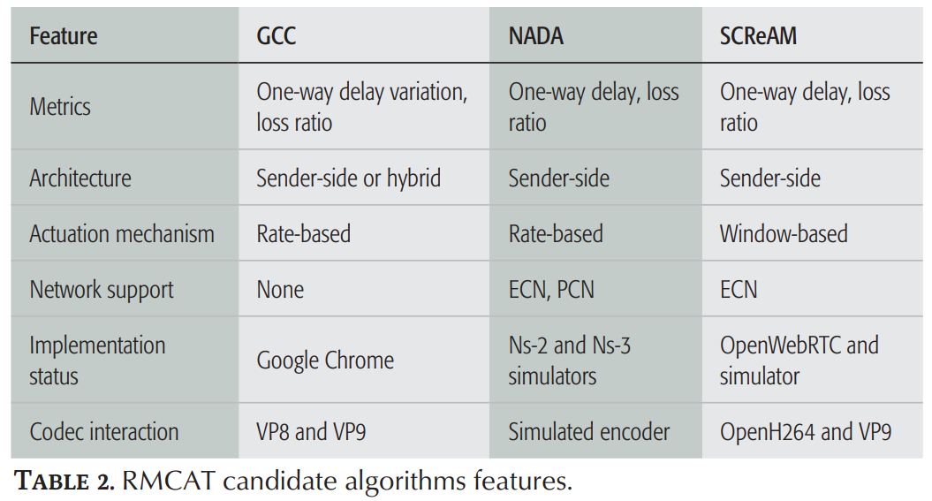
Design: Zhuge
Feedback Updater
Why is Explicit Congestion Notification (ECN) not working?
Many delay-based CCAs do not react to ECN, according to the literature*.
Even if some do, the wireless link delays still cannot be reduced.
*De Cicco et al. "Congestion control for webrtc: Standardization status and open issues." IEEE Communications Standards Magazine 1.2 (2017): 22-27.
*“Copa doesn't react to loss/ecn” from https://github.com/venkatarun95/ccp_copa/issues/3
Notes:
Let’s first take a look at the out of band feedback.
Let’s see the timeline of a normal TCP packet when the network congestion starts to accumulate.
For two packets with sequence number k and k + 1, when the downlink capacity is reduced, at here, this is the first time when sequence number k + 1 experiences an increased delay.
And then these two packets need to be reflected to the server, which is too late.
Okay so what will Zhuge do in this case?
Actually when the packet with sequence k + 1 arrives at the access point, if the downlink capacity is reduced, it could have already been predicted here.
Suppose there are other packets in the reverse direction from the client to the server, such as ack j + 1 and j + 2, Zhuge can directly manipulate the delay intervals between them by delaying the second ack packet.
In this case, the server will know the delay is increasing in the network now.
And the control loop will be reduced as marked in green.

Slide 36



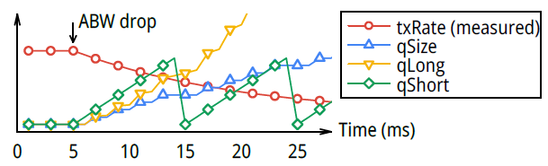
Design: Zhuge
Fortune Teller
totalDelay = qLong + qShort + tx
qLong = cur(qSize) / avg(txRate)
qShort = cur(QFrontWaitTime)
tx = avg(dequeueIntvl)

Slide 37
Evaluation
Testbed Experiments

